Slide 1
What is clustering ?
Is it supervised method of ML ?
when should we use clustering ?
what are the different types of clustering?
most popular clustering algorithms and when to use them and whats the drawback of each?
How to prepare the data for clustering ?
Interpret the result and adjust the clustering ?
Real world scenarios where clustering algorithms are used ?

Slide 2
What is clustering ?
In machine learning systems, we often group examples as the first step towards understanding the dataset. Grouping an unlabelled example is called clustering
Before you can group similar examples, you first need to find similar examples. You can measure similarity between examples by combining the examples' feature data into a metric, called a similarity measure. When each example is defined by one or two features, it's easy to measure similarity. For example, you can find similar books by their authors. As the number of features increases, creating a similarity measure becomes more complex. We'll later see how to create a similarity measure in different scenarios.
It's worth noting that clustering is an unsupervised learning technique, meaning that it does not rely on labeled training data. Instead, it explores the inherent structure of the data to find meaningful patterns or groupings.

Slide 3
Few More points about clustering
No "Ground Truth": Unlike supervised learning, clustering does not have a predefined ground truth or correct answers. It is a subjective task, and the interpretation of clusters can vary depending on the context and the domain of application.
Exploration and Discovery: Clustering is often used as an exploratory data analysis technique to discover hidden patterns or structures within the data. It can provide insights into the relationships and similarities between data points that may not be immediately apparent
Feature Selection: The choice of features or variables used for clustering can significantly impact the results. Selecting relevant and informative features is crucial to capture the underlying structure of the data accurately. Dimensionality reduction techniques such as Principal Component Analysis (PCA) or t-SNE are often applied to preprocess the data and reduce the feature space.

Slide 4
Practical Scenarios where clustering is used
Customer Segmentation: Clustering is commonly employed in marketing to segment customers based on their purchasing behavior, preferences, demographics, or other relevant attributes
Image and Object Recognition: Clustering is utilized in computer vision tasks such as image segmentation and object recognition. By clustering pixels or image regions with similar characteristics, it becomes possible to separate foreground from background or identify different objects within an image.
Anomaly Detection: Clustering can be used for detecting anomalies or outliers in datasets. By clustering normal instances, any data point that does not belong to any cluster or forms a separate cluster can be considered as an anomaly. This approach is useful for fraud detection, network intrusion detection, or identifying unusual patterns in healthcare monitoring.

Slide 5
Recommendation Systems: Clustering is utilized in recommendation systems to group similar users or items. By clustering users with similar preferences or item characteristics, personalized recommendations can be generated. This helps in e-commerce, movie/music recommendations, and content filtering.
Image Compression: Clustering is used in image compression techniques like vector quantization or k-means clustering. By clustering similar pixel blocks, image data can be represented more compactly, leading to reduced storage requirements and faster transmission.
Social Network Analysis: Clustering is utilized in social network analysis to identify communities or groups within a network. By clustering individuals based on their social connections, shared interests, or interaction patterns, it becomes possible to understand the network structure, influence propagation, or target specific groups for marketing or social interventions.

Slide 6
Different types of clustering methods?
The cluster formation depends upon different parameters like shortest distance, graphs, and density of the data points. Grouping into clusters is conducted by finding the measure of similarity between the objects based on some metric called the similarity measure.
Typical cluster models include:
Connectivity models – like hierarchical clustering, which builds models based on distance connectivity.
Centroid models – like K-Means clustering, which represents each cluster with a single mean vector.
Distribution based clustering – like Gausian Mixture Models, here, clusters are modeled using statistical distributions.
Density models – like DBSCAN which define clustering as a connected dense region in data space.
Fuzzy Clustering

Slide 7
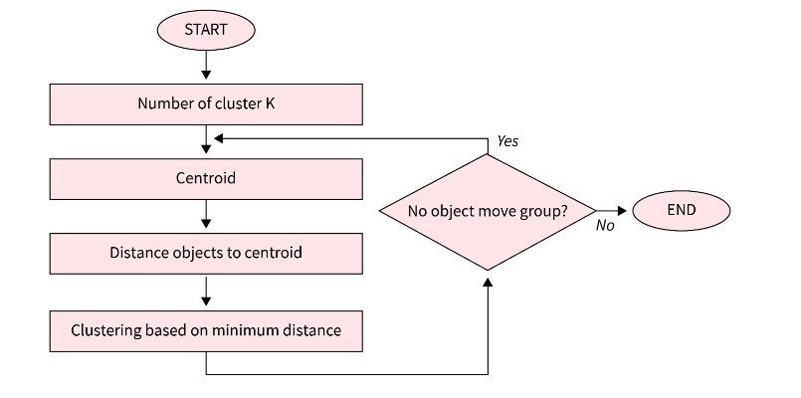
Centroid Based Models/Partitioning methods
Partitioning methods are a widely used family of clustering algorithms in data mining that aim to partition a dataset into K clusters
These algorithms attempt to group similar data points together while maximizing the differences between the clusters.
Partitioning methods work by iteratively refining the cluster centroids until convergence is reached
Link

Slide 8
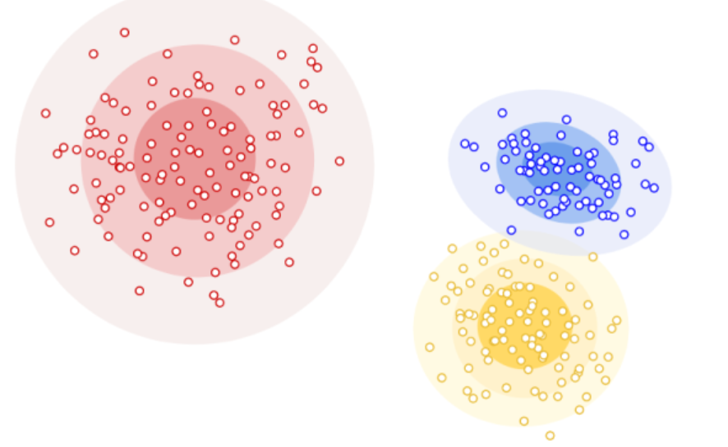
Distribution based clustering
Clusters can then be defined as objects that belong to the same distribution.
Gaussian mixture model (GMM) is one of the types of distribution-based clustering. These clustering approaches assume data is composed of distributions, such as Gaussian distributions.
As the distance from the distribution increases, the probability that the point belongs to the distribution decreases.
The bands show a decrease in probability in the below image

Slide 9
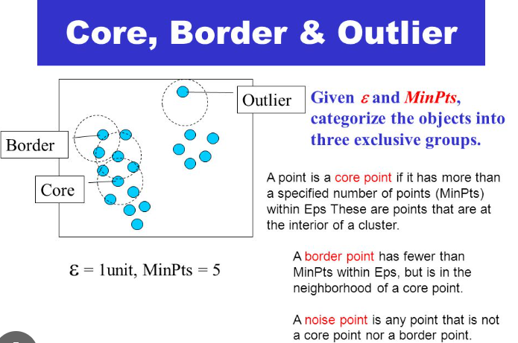
Density-based clustering algorithms
Density-Based Clustering is a type of clustering algorithm that identifies clusters based on the density of data points in the dataset.
It is particularly effective for discovering clusters of arbitrary shape
This type of clustering technique connects data points that satisfy particular density criteria (minimum number of objects within a radius)
The most widely used density-based clustering algorithm is DBSCAN

Slide 10
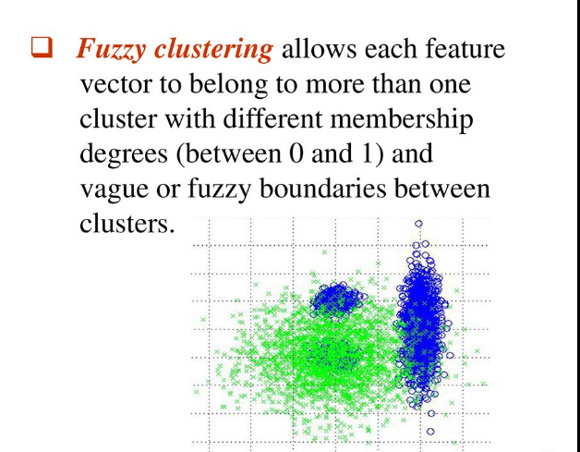
Fuzzy Clustering
Fuzzy clustering, also known as soft clustering, is a clustering technique that assigns each data point a degree of membership to each cluster
In fuzzy clustering, the degree of membership is represented by a membership value ranging between 0 and 1, where a value of 1 indicates a full membership in a cluster, while a value of 0 indicates no membership
It iteratively assigns membership values to data points and adjusts cluster centroids based on the membership values.
Compute the membership values for each data point, indicating the degree of belongingness to each cluster, using a membership function based on the distances between data points and cluster centroids.
Update the cluster centroids by computing the weighted average of data points based on their membership values

Slide 11
Popular Clustering Algorithms
K-Means clustering
Mean Shift
Hierarchical Agglomerative clustering
Gaussian Mixture Model
DBSCAN

Slide 12
K-means Clustering
Here is a high-level overview of the k-means algorithm:
Initialization: Randomly select k data points from the dataset as initial cluster centroids. These centroids represent the initial cluster centers.
Assignment Step: Assign each data point to the cluster with the nearest centroid. This is done by calculating the Euclidean distance between each data point and all centroids and assigning the data point to the cluster associated with the nearest centroid.
Update Step: Recalculate the centroids of each cluster by taking the mean (average) of all data points assigned to that cluster. The centroids represent the updated cluster centers.
Iteration: Repeat the assignment and update steps iteratively until convergence. Convergence occurs when the cluster assignments no longer change or when a predefined number of iterations is reached.
Final Result: Once convergence is achieved, the algorithm produces the final clustering solution, where each data point is assigned to one of the k clusters.
The k-means algorithm aims to minimize the within-cluster sum of squares (WCSS), which represents the sum of the squared distances between each data point and its assigned centroid. Minimizing WCSS results in tight and compact clusters.

Slide 13
However, k-means has some limitations to be aware of:
Dependency on Initial Centroids: The algorithm's outcome can be sensitive to the initial selection of centroids. Different initializations can lead to different clustering results, so running the algorithm multiple times with different initializations is advisable.
Determining the Optimal k: The user needs to specify the desired number of clusters, k, in advance. Selecting the appropriate value of k can be challenging and may require domain knowledge or using techniques like the elbow method or silhouette analysis.
Limited to Euclidean Distance: K-means uses Euclidean distance to calculate similarity. Therefore, it may struggle with datasets that have irregular shapes or clusters that are not well-separated in Euclidean space.
Elbow Method
Plot the number of clusters (k) on the x-axis and the corresponding WCSS on the y-axis.
Examine the resulting curve. As k increases, WCSS tends to decrease since increasing the number of clusters allows for more precise fit to the data. However, beyond a certain point, adding more clusters may not yield significant improvements in WCSS reduction.
Look for a noticeable bend or "elbow" in the curve. The point where the reduction in WCSS starts to slow down and the curve forms an elbow shape is considered a potential choice for the optimal number of clusters
It's important to note that the elbow method is not a definitive solution but rather a heuristic approach for estimating the appropriate number of clusters. The choice of k still depends on domain knowledge, problem requirements, and interpretability.

Slide 14
Mean Shift
The goal of Mean Shift clustering is to discover clusters in the data by iteratively shifting the centroids of candidate clusters towards the regions of higher data point density. The algorithm operates in the following steps:
Initialization: Assign each data point a random centroid or initialize centroids at random locations in the feature space.
Calculate the mean shift vector: For each data point, calculate the mean shift vector, which represents the direction towards the densest region of data points. The mean shift vector is calculated as the weighted average of the vectors pointing from each data point to all other data points.
Shift centroids: Update the centroids by shifting them along the mean shift vector. The shift magnitude is determined by the bandwidth parameter, which controls the scale of the kernel function. The centroids move towards regions of higher data density.
Convergence: Repeat steps 2 and 3 until convergence is reached. Convergence is typically determined by a threshold, such as the maximum shift magnitude of centroids. If the shift magnitude falls below the threshold, the algorithm stops.
Cluster assignment: After convergence, assign each data point to the closest centroid based on a distance metric, such as Euclidean distance. This step forms the final clusters.

Slide 15
Mean Shift clustering has several advantages:
It does not require specifying the number of clusters in advance. The algorithm automatically determines the number of clusters based on the data density.
It can handle non-linear and irregularly shaped clusters.
It does not make any assumptions about the shape or size of clusters, making it more flexible than certain parametric clustering algorithms.
However, Mean Shift clustering has some limitations:
It can be computationally expensive, especially for large datasets, as the algorithm iteratively calculates mean shift vectors and updates centroids.
The choice of the bandwidth parameter can significantly impact the results. A small bandwidth may result in many small, fragmented clusters, while a large bandwidth may merge distinct clusters.
It may struggle with datasets of varying densities, as it tends to create a single, large cluster around regions of high density and smaller clusters around regions of low density.

Slide 16
Hierarchical Agglomerative clustering
It starts by considering each data point as an individual cluster and merges clusters iteratively until a desired number of clusters or a specific criterion is met. Here's an overview of the algorithm:
Initialization: Begin with each data point considered as a separate cluster.
Compute pairwise distances: Calculate the distance or dissimilarity between each pair of clusters. The choice of distance measure depends on the data and the problem at hand, such as Euclidean distance for continuous data or a suitable dissimilarity measure for categorical data.
Merge closest clusters: Find the two closest clusters based on the computed distances and merge them into a single cluster. The distance between merged clusters can be defined in different ways, such as the distance between centroids, the distance between the closest pair of points from different clusters (single-linkage), or the distance between the farthest pair of points (complete-linkage).
Update distance matrix: Recompute the distances between the new merged cluster and all other clusters. This step depends on the linkage criterion chosen in the previous step.
Repeat steps 3 and 4: Continue merging the closest clusters and updating the distance matrix until a termination condition is met. This condition could be reaching a desired number of clusters or a specific threshold on the distance.
Create dendrogram: Construct a dendrogram or tree-like structure that represents the hierarchy of clusters. The vertical axis of the dendrogram represents the distance or dissimilarity between clusters, and the horizontal axis represents the clusters or data points.
Cut the dendrogram: Determine the number of clusters desired by cutting the dendrogram at a specific height or distance threshold. This step determines the final clustering solution
It can be computationally expensive, especially for large datasets, as the time complexity is O(n^3), where n is the number of data points.

Slide 17
Gaussian Mixture Model
The algorithm for fitting a The Gaussian Mixture Model (GMM) to a dataset typically involves an iterative approach called the Expectation-Maximization (EM) algorithm. Here's an overview of the algorithm:
Randomly assign a centroid
E-step (Expectation step):
Compute the responsibility or posterior probabilities of each data point belonging to each component. This is done using Bayes' theorem and the current parameter estimates.
The responsibility of a data point for a particular component is the probability that the data point belongs to that component, given the current parameter estimates.
M-step (Maximization step):
Update the parameters of the GMM based on the computed responsibilities.
Update the mean vectors by taking the weighted average of the data points, where the weights are the responsibilities.
Update the covariance matrices by taking the weighted covariance of the data points, where the weights are the responsibilities.
Update the mixing coefficients by taking the average of the responsibilities across all data points.
Repeat steps 2 and 3 until convergence

Slide 18
DBSCAN
The algorithm groups together data points that are densely packed while marking points that lie in low-density regions as noise. Here's an overview of the DBSCAN algorithm:
Parameter selection: Choose the parameters for the algorithm: the neighborhood radius (epsilon, ε) and the minimum number of points (minPts) required to form a dense region.
Core point identification: For each data point in the dataset, calculate the distance to all other points. If the number of points within a distance of ε is greater than or equal to minPts, mark the point as a core point.
Density-reachable point identification: For each core point, recursively find all points that are directly or indirectly density-reachable from that core point. A point is considered density-reachable if it is within a distance of ε from another core point.
Cluster formation: Assign each density-reachable point to the same cluster as its corresponding core point. If a point is density-reachable from multiple core points, it can be assigned to any one of the clusters.
Noise identification: Identify points that are not density-reachable from any core points as noise points.
The algorithm's performance can deteriorate for high-dimensional datasets due to the curse of dimensionality.

